Slide 1
Python Bootcamp
August 12, 2018
Vivek Singh
Information Systems Decision Sciences (ISDS)
Muma College of Business
University of South Florida
{vivek4}@mail.usf.edu

Slide 2









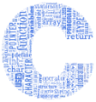
About Me !!
Professional Experience
Technologies
Teaching @ USF
Spring 2017
ISM 4930: Applied Data Science (Cloud computing and Real-time Business)
1st R Bootcamp [January 27, 2017]
2nd R Bootcamp [February 17, 2017]
Fall 2017
ISM 3113: System Analysis Design
3rd R Bootcamp [August 18, 2017]
Sprint 2018
ISM 4220: Business Data Communications
1st Python Bootcamp [August 11, 2017]
Fall 2018
ISM 3113: System Analysis Design

Slide 3
Why Python?
Machine Leaning
Deep Learning
Future AI
AI
CPU
GPU
Quantum Computing
Hardware
Python
Python
Libraries
Scikit
Tensorflow
ProjectQ
Notes:
IBM Q is a cloud-based quantum computing platform.
ProjectQ: https://projectq.ch/
ProjectQ paper: https://arxiv.org/abs/1612.08091

Slide 4
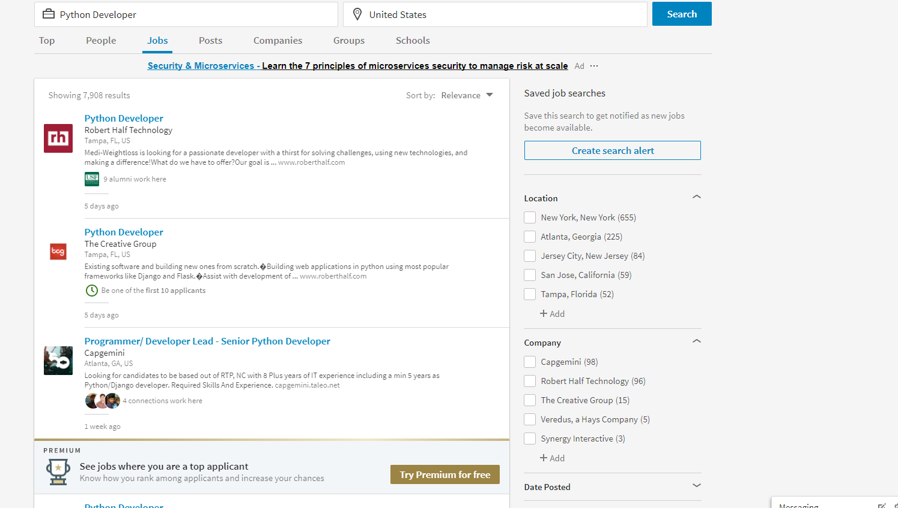
Python Developer Jobs
~ 8000 Jobs

Slide 5
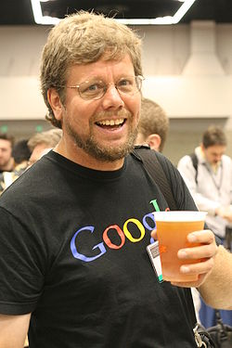
Python programming
Guido van Rossum – author of Python programming
First release in 1991
Open-source software

Slide 6
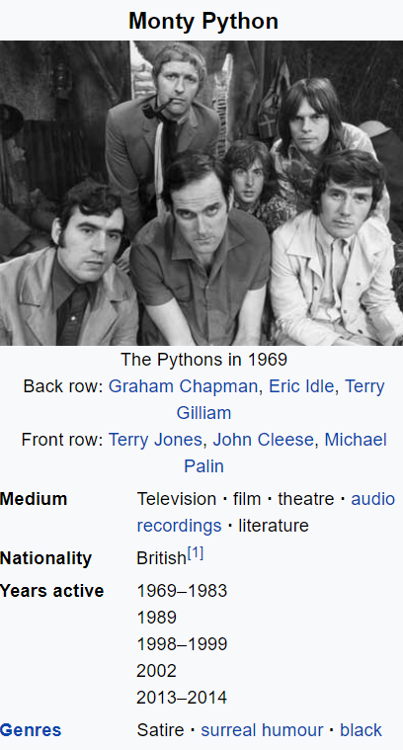
Why was it named ‘Python’?
“I chose Python as a working title for the project, being in a slightly irreverent mood (and a big fan of Monty Python's Flying Circus).” (Guido 1996)
Letter from Guido (1996), https://www.python.org/doc/essays/foreword/

Slide 7
Python’s indentation
“… the use of indentation reduces visual clutter and makes programs shorter, thus reducing the attention span needed to take in a basic unit of code. Second, it allows the programmer less freedom in formatting, thereby enabling a more uniform style, which makes it easier to read someone else's code.” (Guido 1996)
Letter from Guido (1996), https://www.python.org/doc/essays/foreword/

Slide 8
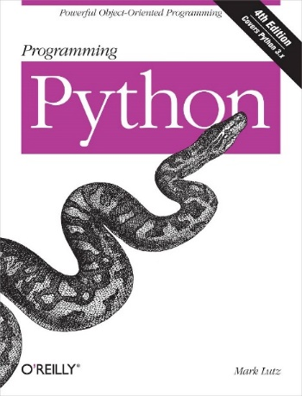
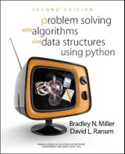
Reference books
Programming Python
Forwarded by Guido (Author of Python)*.
Available online via USF library.
Problem Solving with Algorithms and Data Structures using Python
Available online: http://interactivepython.org/runestone/static/pythonds/index.html
*https://www.python.org/doc/essays/foreword/
Notes:
https://ebookcentral-proquest-com.ezproxy.lib.usf.edu/lib/usf/detail.action?docID=625412

